Slide 1
Chapter - 6
Integration of Information
Models and Decision Support

Slide 2
Data & System Integration
Everyone in the company including managers, salespeople, and engineers need access to the same data across the organization.

Slide 3
Business Integration Example
Daily Sales Report
Daily Sales Report February 7, 2004
Department Item# Q-sold Price Value
House 1153 52 2.95 153.40
5543 13 0.59 7.67
W.Clothing 5563 1 87.32 87.32
7765 4 54.89 219.56
9986 2 15.69 31.38
Shoes 1553 2 65.79 131.58
6673 1 29.39 29.39
Total Sales: 660.30
Returned Merchandise Log
February 7, 2004
Item# Q Price Value
1153 3 2.95 8.85
3353 6 27.59 165.54
4453 2 15.95 31.90
8878 1 24.95 24.95
Total 12 231.24
Commissions February 7, 2004
Emp# Name Dept Sales Rate Amount
1143 Jones House 543.95 5% 27.20
2895 Brown M.Clothing 775.35 4% 31.01
4462 Smith W.Clothing 1,544.52 5% 77.23
7893 Torrez Shoes 876.93 6% 52.62
9963 Cousco M.Clothing 589.47 5% 29.47

Slide 4
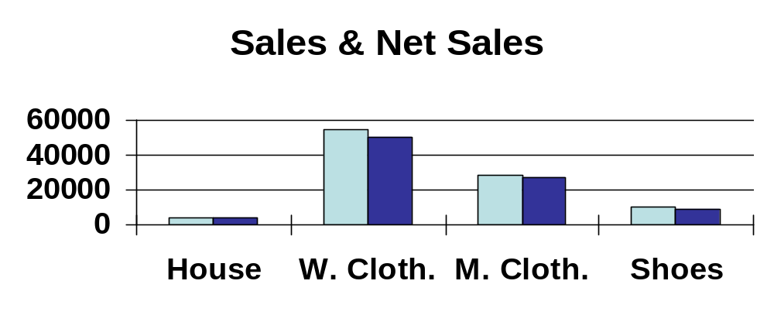
Integrated Report Example
Weekly Sales Analysis 2/01/06 - 2/07/06
Manager comments are written in the first ten pages,
along with comments on special events.
Department Analysis
Dept Sales Returns Commissions Net
House 4,113.58 25.35 205.68 3,882.55
W.Clothing 54,221.92 998.52 3,024.64 50,198.76
M.Clothing 28,664.48 356.24 1,421.58 26,886.66
Shoes 10,225.31 853.47 592.36 8,779.48
Total: 97,225.29 2,233.58 5,244.26 89,747.45

Slide 5
1960s & 1970s MIS Pieces
Accounting:
Integrated Data
Separate
Reports
Marketing:
Forecasts
Production:
MRP
Purchasing:
Orders
Sales:
Orders

Slide 6
Changes
Sales
Terminals
1970s
Management
sales
Central
computer:
create reports
Manager:
Integrate, graph
analyze
data
Sales
Terminals
3 reports
Secretary:
type & revise
(printed)
Sales
Terminals
1980s
Management
3 reports
Central
computer:
create reports
(printed)
Manager:
Integrate, graph
analyze
sales
weekly reports
data
Sales
Terminals
PC
Sales
Terminals
1990s
Management
query
Personal Computer
Weekly reports &
ad hoc queries
(applications)
sales
DBMS:
On-line data
data
Sales
Terminals
data

Slide 7
Integration in 2000s
Management
Sales
Terminals
query
Executive Information
System
PC
PDA
Web Browser
sales
DBMS
data
Sales
Terminals
data
Enterprise Resource Planning
Suppliers
Production/
Service
Banks

Slide 8
Business Integration
Design feasibility
& production costs
Design &
Engineering
Designs and Quality
Marketing
product planning
Quality control
& Custom orders
planning
& monitoring
Production
planning
& monitoring
Vendors
Customers
Purchasing
Distribution
Demand-pull
Mass
Customization
Quick
Response
Just-in-Time
Management
partnerships
& joint
development
partnerships
& joint
development
HRM
Accounting
Finance
MIS

Slide 9
What does ERP deliver ?
a single database that contains all data for the software modules
Manufacturing
  Engineering, Bills of Material, Scheduling, Capacity, Workflow Management, Quality Control, Cost Management, Manufacturing Process, Manufacturing Projects, Manufacturing Flow
Supply Chain Management
  Inventory, Order Entry, Purchasing, Product Configurator, Supply Chain Planning, Supplier Scheduling, Inspection of goods, Claim Processing, Commission Calculation
Financials
  General Ledger, Cash Management, Accounts Payable, Accounts Receivable, Fixed Assets
Projects
  Costing, Billing, Time and Expense, Activity Management
Human Resources
  Human Resources, Payroll, Training, Time & Attendance, Benefits
Customer Resources and Marketing
  Sales and Marketing, Commissions, Service, Customer Contact and Call Center support
Data Warehouse
  and various Self-Service interfaces for Customers, Suppliers, and Employees

Slide 10
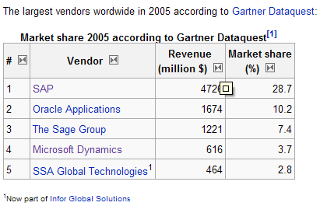
The largest ERP vendors worldwide
Locals – NETSIS, LOGO, LIKOM.

Slide 11
ERP Integration
Headquarters
(France)
Subsidiary
(Spain)
Database
Use inventory item.
subtract quantity.
Update inventory value.
Check for reorder point.
Order new item through EDI.
Update Accounts payable.
Database
Financial data
General ledger
Payroll
…
Manufacturing
Product details
Inventory
…
Weekly financial status.
Cash flow.
Budget versus actual cost.
Project cost report.
Daily production report.

Slide 12
ERP – International Environment
  Multiple currencies
  Multiple languages
  Procedures and practices
  Follows local (national) rules
  Follows consolidation rules
  Example
    U.S. firm with European subsidiaries.
    Data is entered once
    European reports are generated for subsidiaries following local rules
    Results are converted and consolidated to U.S. firm following international and U.S. rules

Slide 13
SAP as an Example for ERP S/W
Based in Germany, now worldwide
Support for international transactions and multinational firms
Runs on multiple database and hardware platforms
Can handle large and small companies
Expensive, but price is relative.
Financials
Logistics
Human resource management

Slide 14
SAP Financials
Financial Accounting
  General ledger
  Accounts receivable/payable
  Special ledgers
  Fixed assets
  Legal consolidation
Investment Management
  Investment planning/budgeting/control
  Depreciation forecast/simulation/calculate
Controls
  Overhead cost
  Activity based costing
  Product cost
  Profitability analysis
Treasury
  Cash management
  Treasury management
  Market risk management
  Funds management
Enterprise Control
  Executive information system
  Business planning and budgeting
  Profit center accounting
  Consolidation

Slide 15
SAP Logistics
Product data management
  Master data management
  Design and change process
  Product structure
  Development projects
Sales and distribution
  Sales activities
  Sales order management
  Shipping and transportation
  Billing
  Sales information system
Purchasing
Materials management
Manufacturing/Production
Warehousing
Quality management
Plant maintenance
Service management
Sales
Distribution

Slide 16
SAP Logistics
Production planning and control
  Production planning
  Material requirements planning
  Production control and capacity planning
  Costing
  Order information system
  Shop floor information system
Project system
  Work breakdown structures
  Network planning techniques, milestones
  Cost, revenue, financial, schedule, and resource management
  Earned value calculation
  Project information system

Slide 17
SAP Logistics
Materials management
  Purchasing
  Inventory management
  Warehouse management
  Invoice verification
  Inventory controlling
  Purchasing information system
Quality management
  Quality planning
  Quality inspections
  Quality control
  Quality notifications and certificates
  Quality management information system
Plant maintenance
  Structuring technical systems
  Maintenance resource planning
  Maintenance planning
  System for technical and cost accounting data
  Maintenance information system

Slide 18
SAP Logistics
Service management
  Customer installed base administration
  Service contract management
  Call management
  Billing
  Service information system
Integration
  When the clerk enters a sale, bills are generated automatically (mail, fax, or EDI).
  Sales and revenue are instantly updated in financial and control modules.
  The sales information system and EIS provide various up-to-date views and reports.

Slide 19
SAP HRM
Personnel management
  HR master data
  Personnel administration
  Information systems
  Recruitment
  Travel management
  Benefits administration
  Salary administration
Organizational management
  Organization structure
  Staffing schedules
  Job descriptions
  Planning scenarios
  Personnel cost planning
Payroll accounting
  Gross/net accounting
  History function
  Multi-currency capability
  International solutions
Time management
  Shift planning
  Work schedules
  Time recording
  Absence determination
  Error handling

Slide 20
SAP HRM
Personnel development
  Career and succession planning
  Profile comparisons
  Qualifications assessments
  Additional training determination
  Training and event management
Other features
  SAP Business workflow
  Internet scenarios
  Employee self-service

Slide 21
SAP Integration
Financial general ledger holds all base totals.
Sub-ledgers are defined for important accounts
  Accounts payable
  Manufacturing
  User-defined
  etc.
All transactions automatically flow through
  Including currency conversions
  Special rules can be defined
Simple example
  Manufacturing uses an item from inventory
  The quantity on hand is updated
  The inventory value is automatically changed
    On any sub-ledgers
    On the general ledger
  Reports are generated in any currency
  New orders and payments can be generated through EFT.

Slide 22
Customer Relationship Management
Multiple Contact Points
  The goal is to provide a single, integrated view of all customer activity, available to all employees who interact with the customer.
Feedback, Individual Needs, and Cross Selling
  Having better information enables workers to provide better service, meet the individual needs of each customer.

Slide 23
Workgroups
Computers are increasingly used to support teamwork and workgroups. Data, comments, and analysis are created and shared through networks of computers.

Slide 24
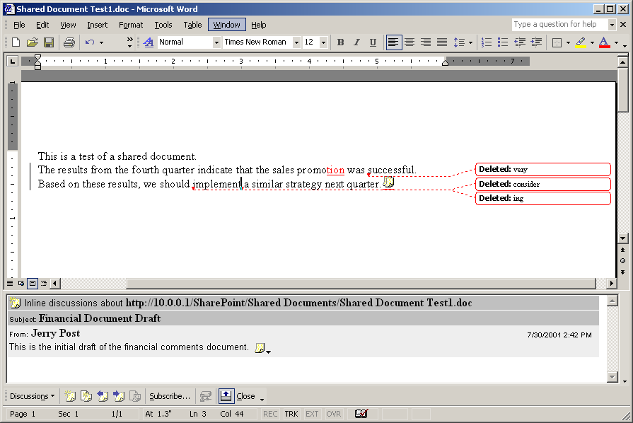
Tracking Changes and Adding Discussions – MS Word

Slide 25
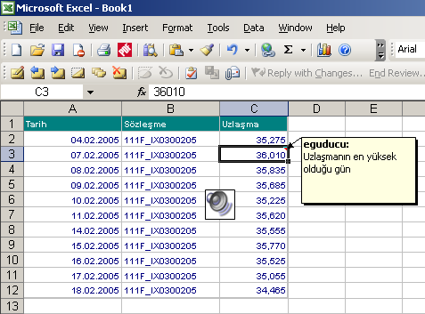
Annotation
Insert - Comment
Insert - Object - Wave
Make sure you and your colleagues have a sound card and microphone.
Set up and test the multimedia tools.
Know what you want to say and keep it short.
Video can be used also but you need a camera, video capture card, and editing software.
Recorded (wave)
comment
Comment

Slide 26
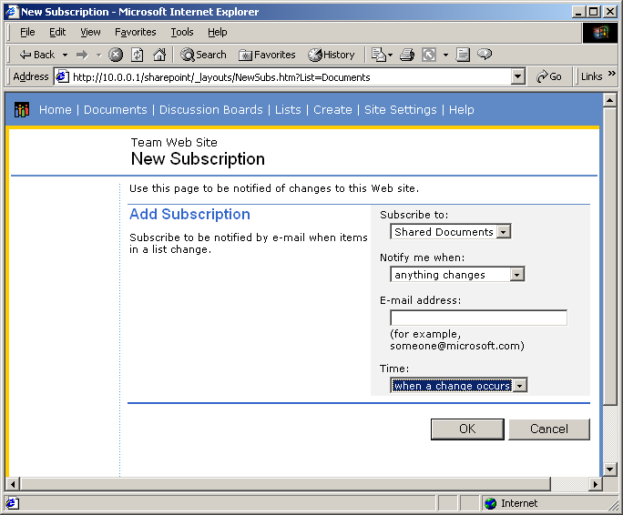
Subscriptions for Documents to Monitor Changes – Shapepoint example
Users can subscribe to a document or a directory.
They will be notified by e-mail when changes are made.
Or notified with a list of changes once a day, once a week, or on whatever schedule the user selects.

Slide 27
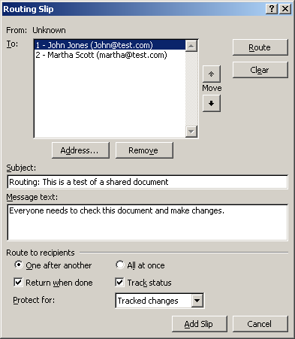
SharePoint: Routing Slip for Workflows
A routing slip sends documents by e-mail to each person on the list in order.
The document records changes and comments.
Users on the list can approve or reject changes.

Slide 28




Workgroup Example
Client HQ
Connecticut
Consulting HQ
California
Cost
Analyses
Design
Proposals
3
Message
Supplier
Contact
Database
Finance & Management Team
Changes &
Suggestions
Cost Analysis
Cost targets
& comments
Costs & Budgets
Design
Proposals
Changes &
Costs
Message
2
Supplier
Contact
Database
Design Team
Singapore
Design Plans
Changes
Changes
& Corrections
Problems &
Suggestions
4
Design Project
origination
1
Message

Slide 29
Problems with Sharing
Same software
  Data conversion tools weak.
  Exact layouts require same versions.
Same environment, fonts, devices, drivers
  Hardware conversions not exact.
  Missing devices might cause crashes.
Need access and network paths.
Transmission time.
Concurrency
  Tracking.
  Locking.
  Replication.

Slide 30
Data Warehouse/Legacy Systems
Interdepartmental
teams
Data
warehouse
Shared access
Analysis
tools
Data
Decision maker manager
Selected
data items
Data
Data
Data
Sales transactions
and production operations

Slide 31
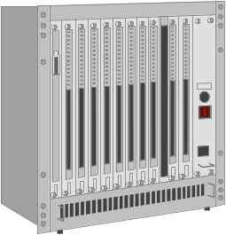


Integration with Diversity
IBM
PC client
central computer
Unix
file server
Radio
Network
Hardware compatibility:
Salesperson’s
support for network connections.
laptop
Software compatibility:
ability to store, transmit and display
data created on different machines.

Slide 32
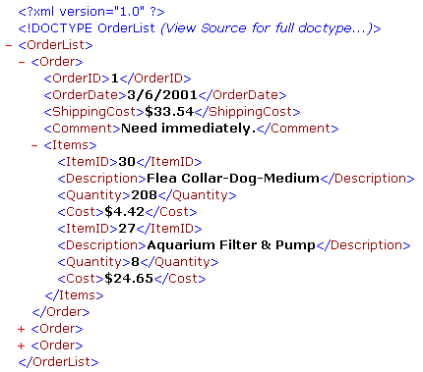
XML: eXtensible Markup Language
Used as a standard means to transfer data to machines with unknown capabilities.
Most hardware and software can read and understand the data.
The tags describe the content.
Usually a separate schema file is used to describe the tags and the document structure.

Slide 33
GDSS
Group Decision Support Systems
  Brainstorming
  Shared access
  Voting
  Record of comments
  Anonymity?
Drawbacks
  Typing
  Facilitator
  Costs

Slide 34
Static Integration
Original
spreadsheet
object
Container
Document
Document
Static copy
of spreadsheet
object
Original
graph
object
Static copy
of graph
object
Copy the objects to the document.
Changes to the original do not affect the copies.

Slide 35
Dynamic Integration
Objects are dynamically linked to the document.
Master/Container Document requests changes and updates copies as needed.
Document
request changes
Container
Document
Original
spreadsheet
object
send data
Dynamic display
of spreadsheet
copy
Original
graph
object
request changes
Dynamic display
of graph copy
send data

Slide 36
Compound Data in a Document
Database
SpreadSheet
Container Document
Text
Graph
Image
Voice

Slide 37
Dynamic Links
Advantages
  Data references are always up-to-date.
  Computer & document know the source of all components.
  Updates and changes are automatic, with less user training.
Disadvantages
  Moving a document forces links to be rebuilt or dropped.
  Cannot make radical changes to underlying components
    Software upgrade problems.
    File deletions, moves and major alterations affect other (unknown) users.
  Data changes can cause reformats that require fine-tuning of layouts.

Slide 38

Network Links for Integration
Sales
Accounting
Integrated Data
Marketing Forecast
Graph
Sales Table
Cost of Goods Sold
Spreadsheet
Marketing

Slide 39
Integration over Networks
Share data
Support links
  Data
  Software availability
Joint Authorship
Transmit reports
File Server
Server
Applications
Container
Document
Circulated
Report
Computer 1
Computer 2

Slide 40
Spreadsheet link to DBMS
Request data
Send data
Fill spreadsheet
Data changes
Send new data
Spreadsheet
(1) Query to
request data
DBMS
(3) Fill spreadsheet
(2) Send data
(5) Send new data
data
(4) Data changes

Slide 41
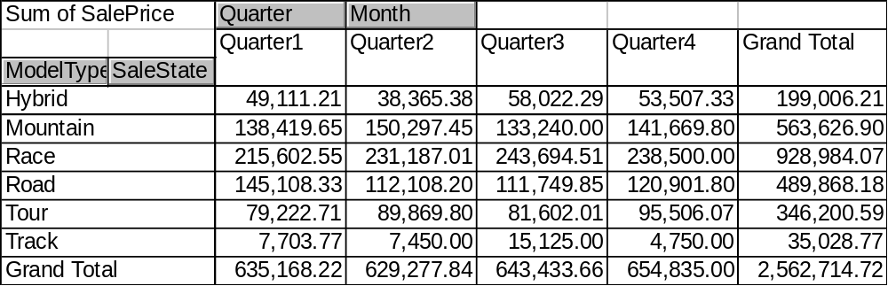
Microsoft Pivot Table
Data - Pivot table report.
Select data using a database query
Choose data for rows, columns and table computations (row: ModelType, SaleState; column: Month(SaleDate); Table: SalePrice.
Create additional groups (Mark quarters, Data - Group and outline - Group.
Hide or show detail.

Slide 42

Protected Changes
Tools - Protect the document.
Save the file and allow others to make changes.
Changes are automatically marked in color for each user.
Tools - Unprotect the document.
Tools - Track Changes - Accept or Reject Changes.

Slide 43
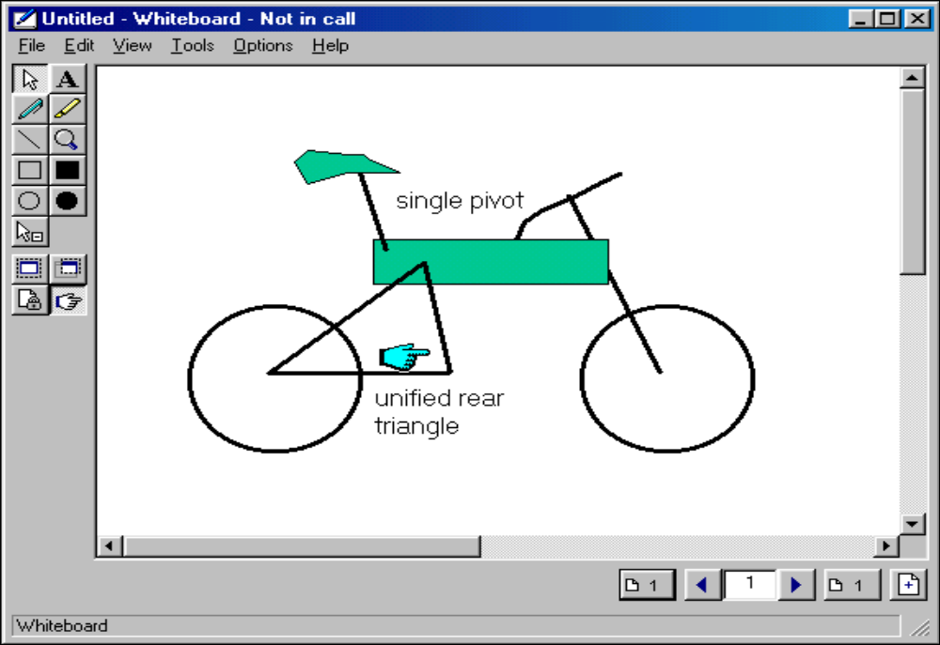
MS NetMeeting WhiteBoard
A simple graphics tool, but it is shared by all participants.
All comments and drawings are sent to the other screens.

Slide 44
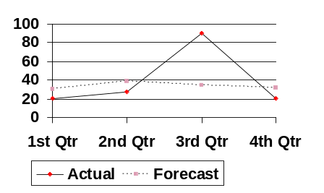
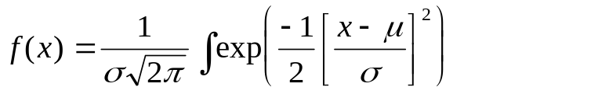
Models
Strategy
Decision
Output
Model
Tactics
Data
Operations
Company

Slide 45
Decision Levels
EIS
Strategic
ES
Mgt.
DSS
Models
Tactical
Management
Transaction
Processing
Process Control
Business Operations

Slide 46
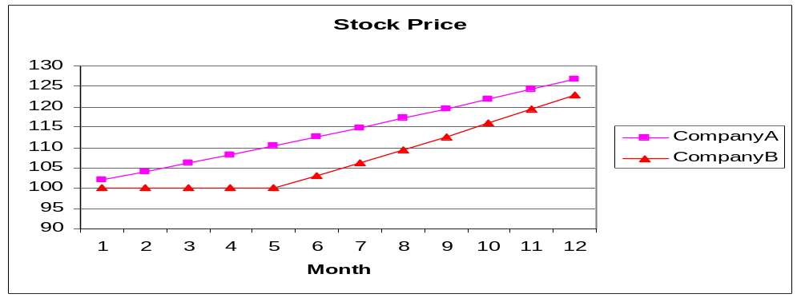
Exmple: Choosing a Stock
Company A’s share price increased by 2% per month.
Company B’s share price was flat for 5 months and then increased by 3% per month.
Which company would you invest in?

Slide 47
Human Biases
Acquisition/Input
  Data availability
  Selective perception
  Frequency
  Solid/concrete information
  Misleading correlation
Processing
  Inconsistency
  Conservatism
  Non-linear extrapolation
  Heuristics: Rules of thumb
  Anchoring and adjustment
  Representativeness
  Sample size
  Justifiability
  Regression bias
  Best guess strategies
  Complexity
  Emotional stress
  Social pressure
  Idleness
Output
  Question format
  Scale effects
  Wishful thinking
  Illusion of control
Feedback
  Learning on irrelevancies
  Misperception of chance
  Success/failure attribution
  Logical fallacies in recall
  Hindsight bias

Slide 48
Why Build Models?
Goal or output
Maximum
Understanding the Process
Optimization
Prediction
Simulation or "What If" Scenarios
Dangers
variables
25
20
Model: defined
by the data points
15
or equation
Output
10
5
5
0
3
1
2
3
4
5
1
6
7
8
9
Input Levels
10
Control variables

Slide 49
Prediction
25
20
Economic/
regression
15
Forecast
Output
10
5
Moving Average
0
Trend/Forecast
Q1
Q2
Q3
Q4
Q1
Q2
Q3
Q4
Q1
Q2
Time/quarters

Slide 50
Simulation
Goal or output
variables
25
20
15
Results from altering
Output
10
internal rules
5
0
1
2
3
4
5
6
7
8
9
10
Input Levels

Slide 51
Object-Oriented Simulation Models
Custom Manufacturing
purchase
order
purchase
order
Customer
routing
Order Entry
& scheduling
Invoice
Parts
List
Shipping
Production
Schedule
Shipping
Inventory

Slide 52
DSS: Decision Support Systems
Sales and Revenue 1994
Model
300
250
Legend
200
Sales
Revenue
150
Profit
sales
revenue
profit
prior
results
Prior
154
204.5
45.32
35.72
100
163
217.8
53.24
37.23
50
161
220.4
57.17
32.78
0
173
268.3
61.93
47.68
Jan
Feb
Mar
Apr
May
Jun
143
195.2
32.38
41.25
Output
data to analyze
181
294.7
83.19
67.52
Database

Slide 53
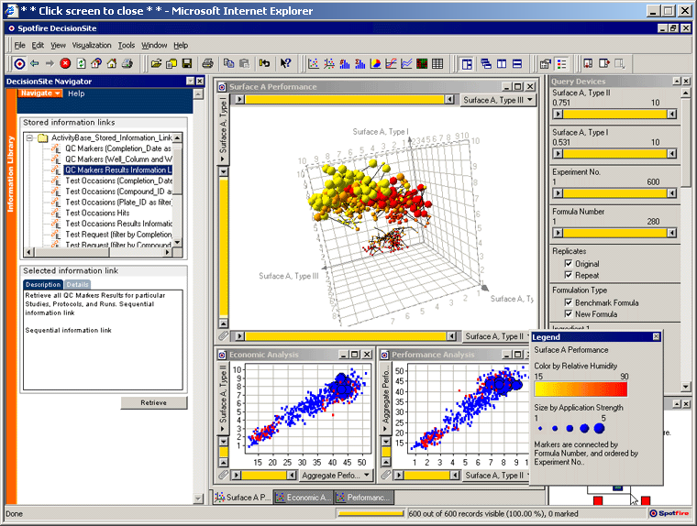
Data Mining: Spotfire
http://www.spotfire.com

Slide 54

Data Warehouse
Predefined
reports
Interactive
data analysis
Operations
data
Daily data
transfer
OLTP Database
3NF tables
Data warehouse
Star configuration
Flat files

Slide 55
Multidimensional OLAP Cube
Pet Store
Item Sales
Amount = Quantity*Sale Price
Category
Customer
Location
Time
Sale Date

Slide 56
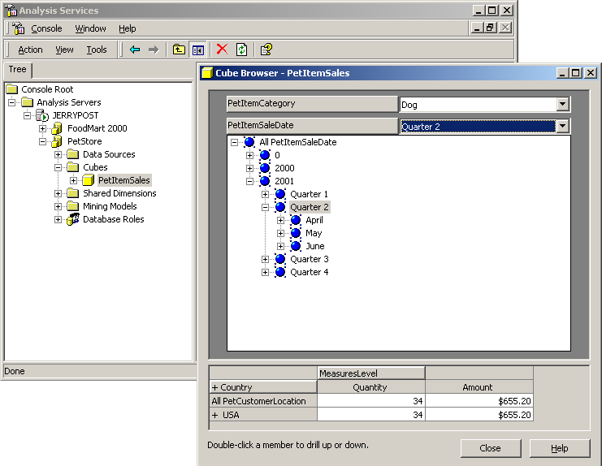
MS SQL Server Cube Browser

Slide 57
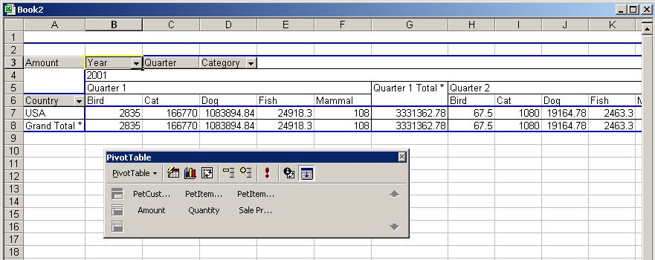
Microsoft Pivot Table

Slide 58
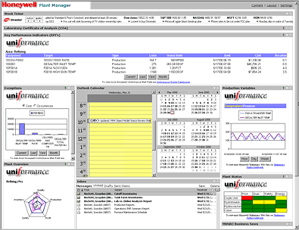
Digital Dashboard
Stock market
Equipment details
Exceptions
Quality control
Plant or
management variables
Products
Plant schedule
http://www.microsoft.com/business/casestudies/dd/honeywell.asp

Slide 59
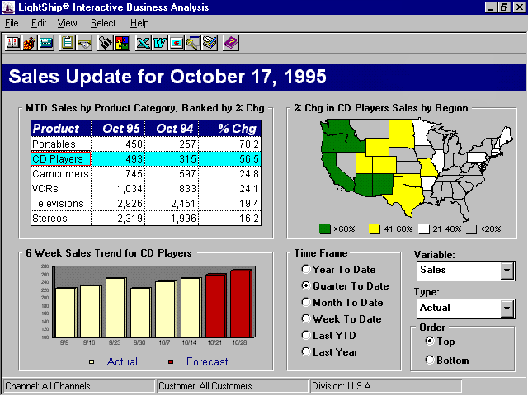
EIS: Executive
Information System
Easy access to data
Graphical interface
Non-disturbing
Drill-down capabilities
EIS Software
from Lightship
highlights ease-
of-use GUI for
data look-up.

Slide 60

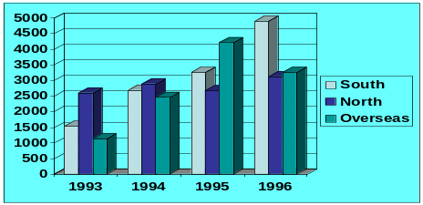




Executive IS
Sales
Production Costs
Distribution Costs
Fixed Costs
Production Costs
South
North
Overseas
Executives
Data for EIS
Central Management
Production: North
Item# 1995 1994
1234 542.1 442.3
2938 631.3 153.5
7319 753.1 623.8
Data
Data
Sales
Data
Production
Distribution
Data

Slide 61
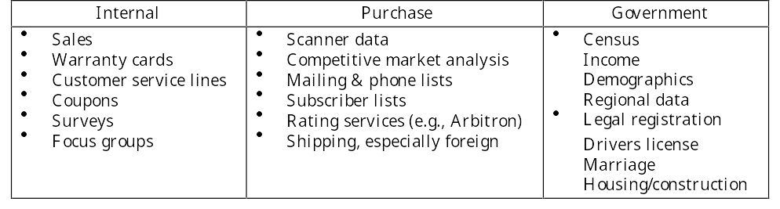
Marketing Research Data

Slide 62
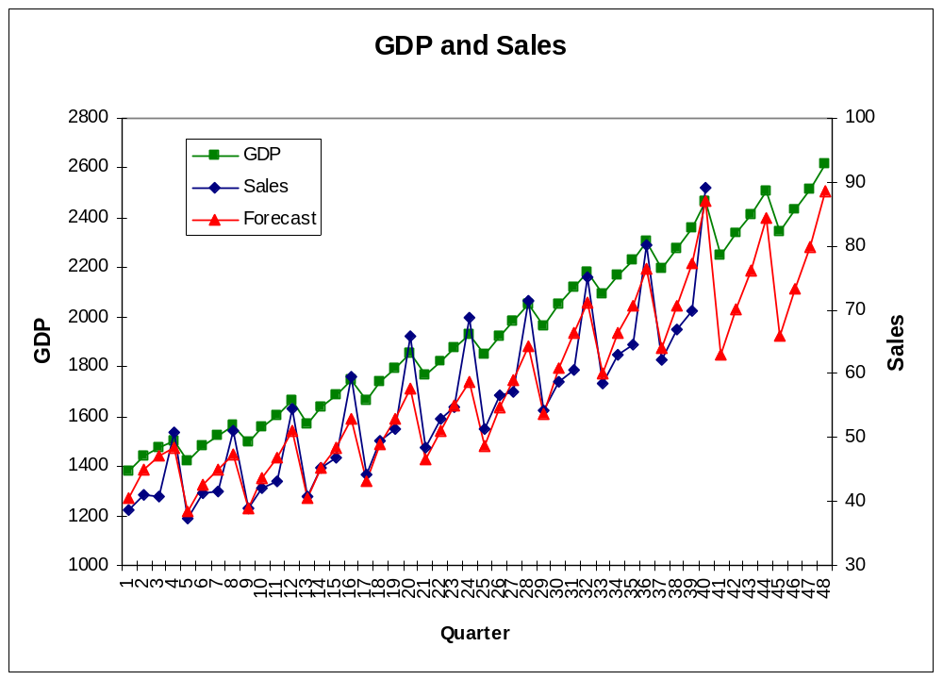
Marketing Sales Forecast
File: C08-10 Marketing Forecast.xls
forecast
Note the fourth quarter sales jump.
The forecast should pick up this cycle.

Slide 63
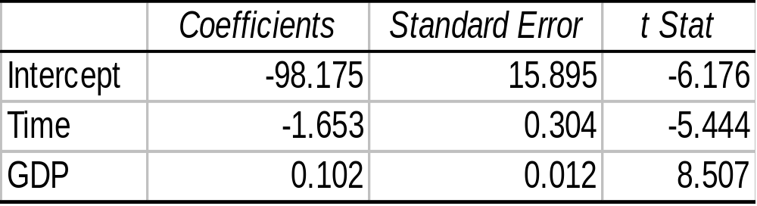
Regression Forecasting
Data:
Quarterly sales and GDP for 10 years.
Model:
Sales = b0 + b1 Time + b2 GDP
Analysis:
Estimate model coefficients with regression.
Forecast GDP for each quarter.
Output:
Compute Sales prediction.
Graph forecast.

Slide 64
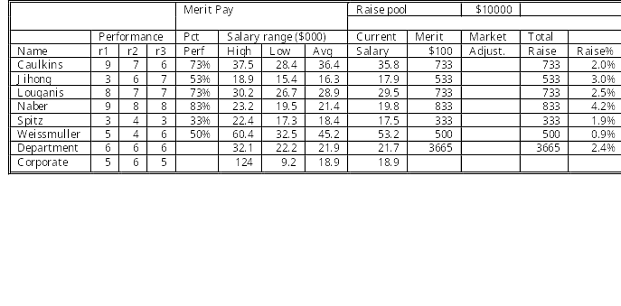
Human Resources

Slide 65
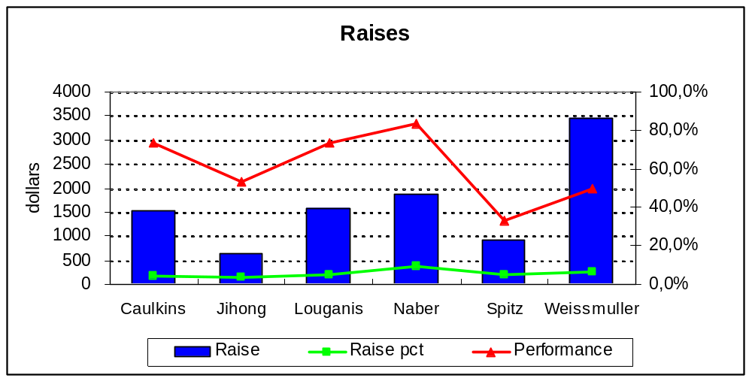
Human Resources

Slide 66
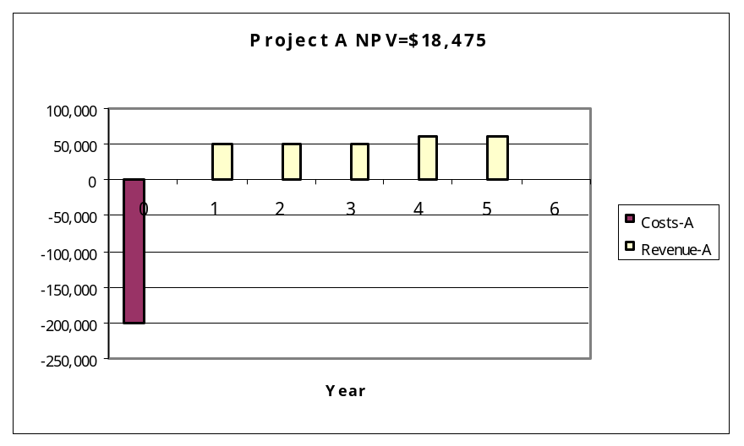
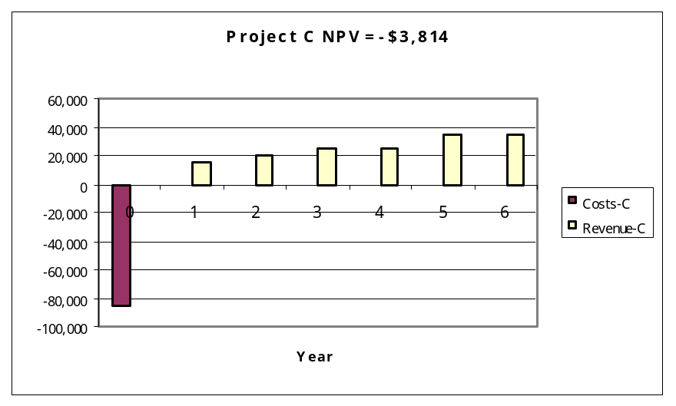
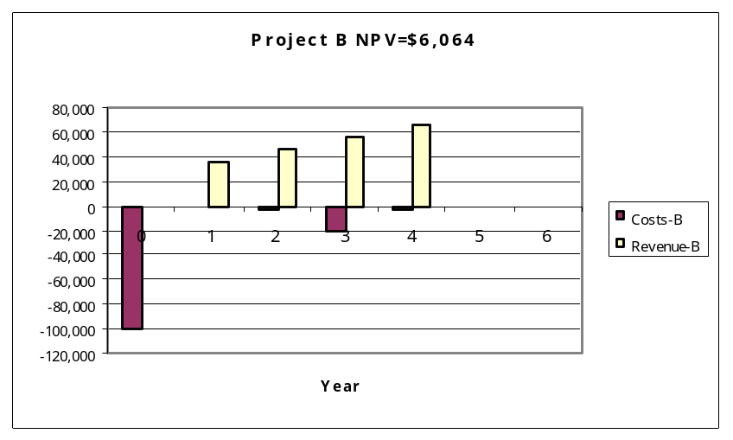
Finance Example: Project NPV
Can you look at these cost and revenue flows and tell if the project should be accepted?
Interest Rate = 7%

Slide 67
Accounting
Balance Sheet for 2006
Cash 33,562 Accounts Payable 32,872
Receivables 87,341 Notes Payable 54,327
Inventories 15,983 Accruals 11,764
Total Current Assets 136,886 Total Current Liabilities 98,963
Bonds 14,982
Common Stock 57,864
Net Fixed Assets 45,673 Ret. Earnings 10,750
Total Assets 182,559 Liabs. + Equity 182,559

Slide 68
Accounting
Income Statement for 2006
Sales $97,655 tax rate 40%
Operating Costs 76,530 dividends 60%
Earnings before interest & tax 21,125 shares out. 9763
Interest 4,053
Earnings before tax 17,072
taxes 6,829
Net Income 10,243
Dividends 6,146
Add. to Retained Earnings 4,097
Earnings per share $0.42

Slide 69
Accounting Analysis
Balance Sheet projected 2004
Income Statement projected 2004
Cash $36,918
Acts Receivable 96,075
Inventories 17,581
Accts Payable $36,159
Notes Payabale 54,327
Accruals 12,940
Sales
$ 107,421
1
2
2
Operating Costs
84,183
Earn. before int. & tax
23,238
Total Cur. Assets 150,576
Total Cur. Liabs. 103,427
5
Interest
4,306
Bonds 14,982
Common Stock 57,864
Ret. Earnings 14,915
Earn. before tax
18,931
Net Fixed Assets 45,673
3
taxes
8,519
Net Income
10,412
Total Assets $196,248
Liabs + Equity 191,188
Dividends
6,274
Add. Funds Need 5,060
Add. to Ret. Earnings
$ 4,165
Bond int. rate 5%
4
Earnings per share
$0.43
Added interest 253
Tax rate 45%
Dividend rate 60%
Shares outstanding 9763
1
Forecast sales and costs.
Sales increase 10%
Operations cost increase 10%
2
Forecast cash, accts receivable, accts payable, accruals.
3
Add gain in retained earnings.
4
Compute funds needed and interest cost.
Add new interest to income statement.
Results in a CIRCular calculation.
5

Slide 70
Forecasting Uses
Marketing
  Future sales
  Consumer preferences/trends
  Sales strategies
Finance
  Interest rates
  Cash flows
  Financial market conditions
HRM
  Labor costs
  Absenteeism
  Turnover
Strategy
  Rivals’ actions
  Technological change
  Market conditions

Slide 71
Forecasting Methods
Structural Models
  Derive underlying models
  Estimate parameters
  Evaluate model
  Focus on explanation and cause
Time Series
  Collect data over time
  Identify trends
  Identify seasonal effects
  Forecast based on patterns
P
S
sales
trend
D’
D
Q
time
Increase in income

Slide 72

Structural Equations
Demand (Q) is a function of
  Price
  Income
  Prices of related products
Model
Q_{D} = b0 + b1 Price + b2 Income + b3 Substitute
Data
Estimate
Q_{D} = 1114 - 0.1 Price + 1.2 Income - 1.0 Substitute
Forecast
33318 = 1114 - 0.1 (155) + 1.2 (20000) - 1.0 (160)
Need to know (estimate) future price, income, and substitute price.

Slide 73
Time Series Components
sales
Seasonal
Trend
time
Dec
Dec
Dec
Dec
1. Trend
2. Seasonal
3. Cycle
4. Random
A cycle is similar to the seasonal pattern,
but covers a time period longer than a year.

Slide 74
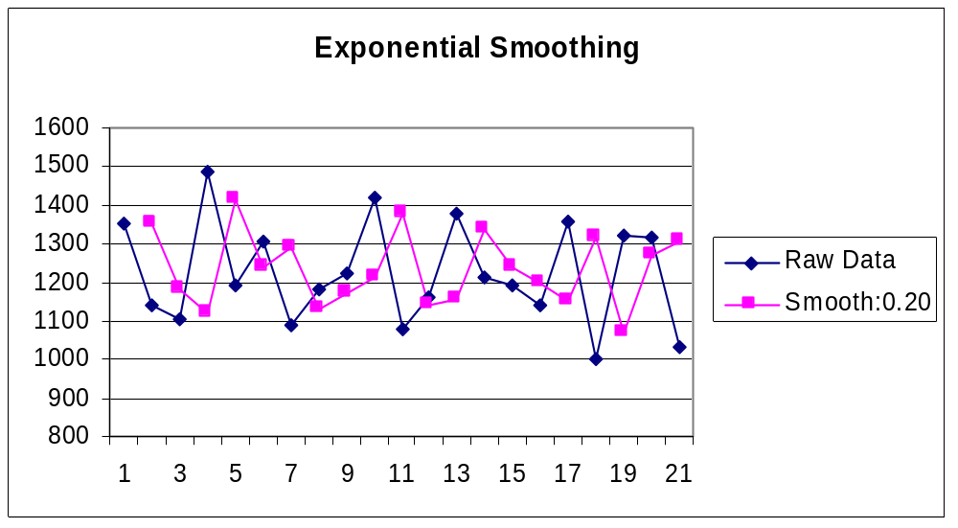
Exponential Smoothing
S_{t} = αY_{t} + (1 - α) S_{t-1}
Use Excel:
Tools, Data Analysis
Exponential Smoothing
S is the new data point
α is the smoothing factor

Slide 75

Exponential Smoothing
Choosing the smoothing factor (α):
It is usually between 0.01 and 0.20
Test multiple values and compare errors:
(actual - smooth) * (actual - smooth)
Compute the sum. Choose the factor with
the least total sum-of-squared error.
Larger factors place
more importance on
recent data, which results in less smoothing.
(A2-D2)*(A2-D2)
Sum
Sum
Sum
929,916
848,686
769,265

Slide 76
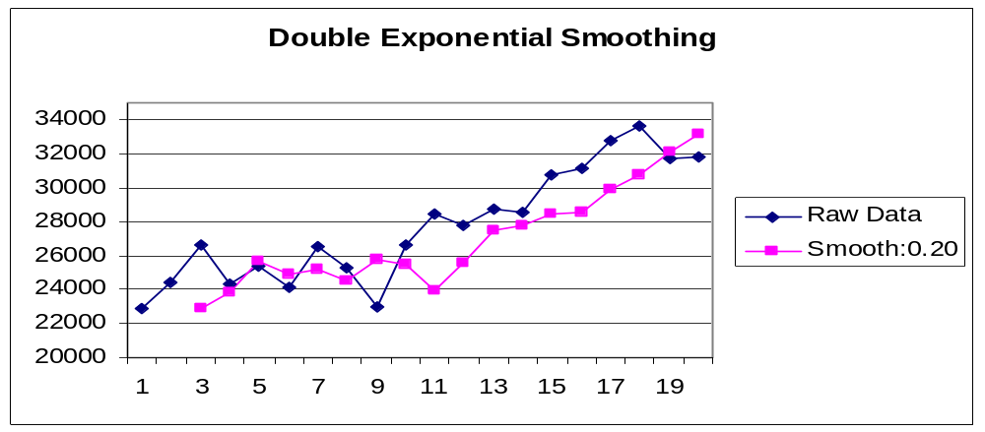
Smoothing with Trends
Apply exponential smoothing and choose smoothing factor (α).
Apply exponential smoothing a second time to the smoothed data.

Slide 77
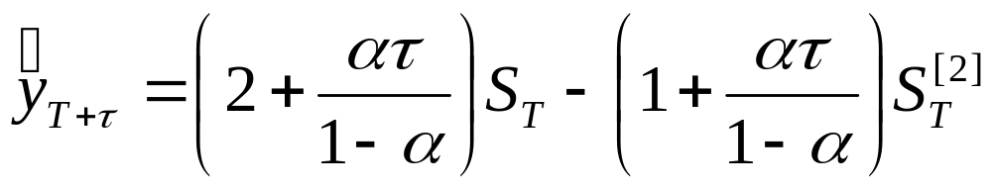
Forecasting with Exponential Smoothing
Forecast for time T+τ
T = 20 last of the raw data
τ = 1 forecast one period ahead
α = 0.2 smoothing factor
S₂₀ = 32,064 (value at time 20, after one smoothing)
S^{[2]} = 33,141 (value at time 20, after second smoothing)
Y₂₁ = (2.25)32,064 - (1.25)33,141
= 30,718

Slide 78
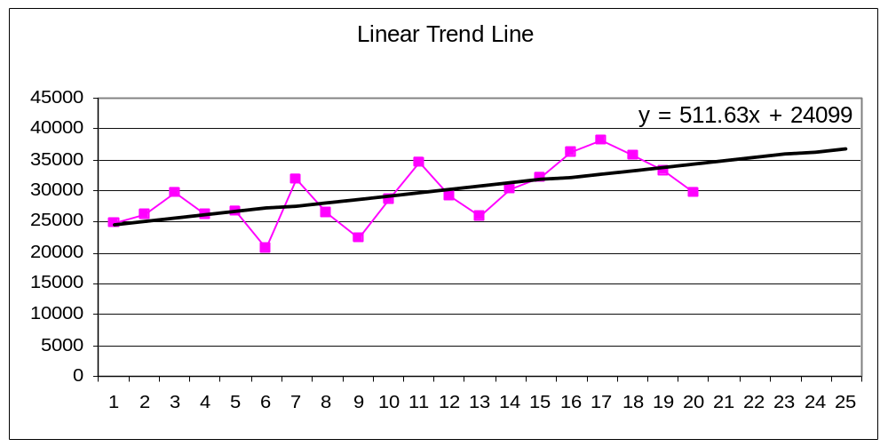
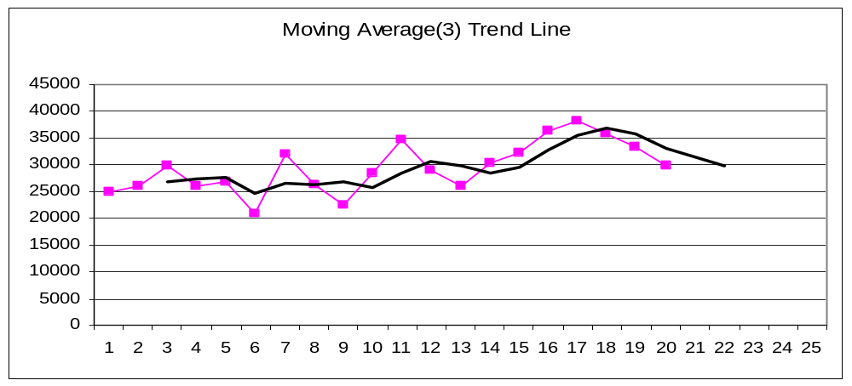
Trendline
Linear captures the trend only.
Moving average captures all elements, but lags the actual pattern.

Slide 79
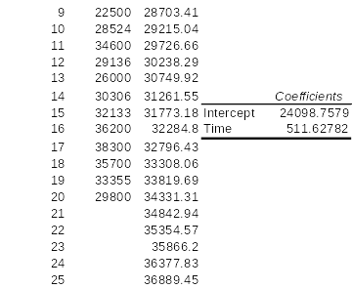
Regression Analysis
Time Sales Forecast
=$F$20+$F$21*B6
Tools + Data Analysis + Regression
Dependent = Sales
Independent = Time

Slide 80
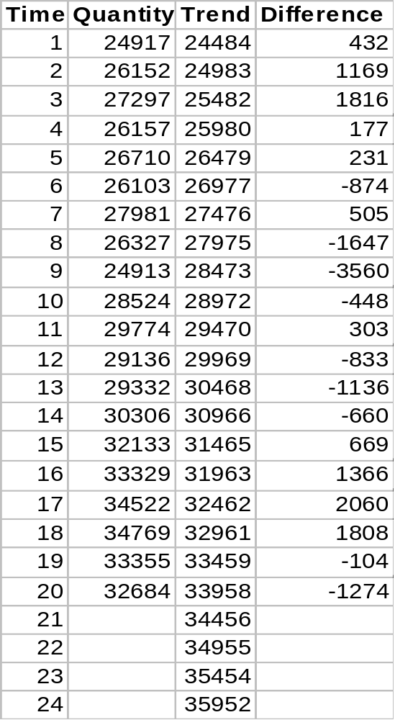
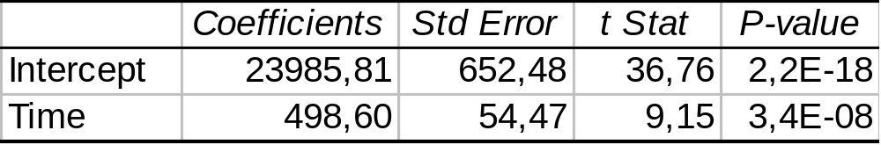
Estimating Trend
Y_{t} = b₀ + b₁(t)
Use regression to estimate b₀ and b₁.
Plug t into equation to estimate new value (on trend):
Y₂₁ = 23,986 + 498.6 * (21)
= 34,456
Result is the prediction on the trend, with no
random factors and no cycles.

